Slide 1
QuickBooks Pro for Municipalities
Quick Course on Setting up Accounts for Fund Accounting

Slide 2
Class Tracking – Fund Accounting
The class tracking feature allows you to define the funds and track their associated balances for Revenues and Expenditures in the Profit and Loss Report. Class tracking for balance sheet accounts is not applicable.
Examples:
General Fund
Water Fund
Sewer Fund
Water Surcharge Fund

Slide 3



Setting up Classes (Funds) in QuickBooks
Edit
Preferences
Accounting
Company Preferences
Under ‘Class’ click box for ‘Use class tracing for transactions and ‘Prompt to assign classes’
Once you establish classes in Company preferences you should be able to add a class in the drop- down box for every check and deposit created in QuickBooks.

Slide 4
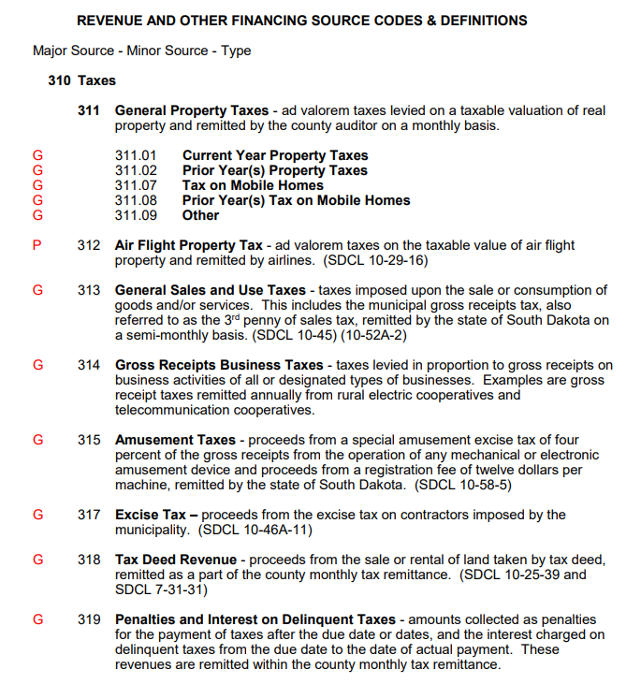
The Chart of Accounts
Revenue and Other Financing
Source Codes and Definitions
Major Revenue Source
Minor Revenue Source or Revenue Type
*The revenue will be recorded at the minor revenue source level or the revenue type, depending upon each source of revenue.

Slide 5
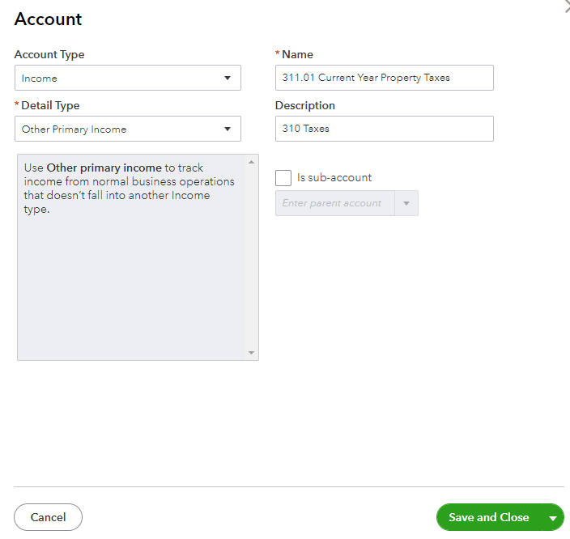
The Chart of Accounts
Adding a New Revenue Account
Select “Lists/Chart of Accounts” from the Menu Bar – Municipal accounting Manual (MAM)
Click the “Account” button & choose “New”
Choose an account type (INCOME)
Choose a detail type (OTHER PRIMARY INCOME)
Type a name (Specific Minor Revenue Source or Revenue Type per MAM)
Type a description (Major Revenue Source)
Click “Save & Close”

Slide 6
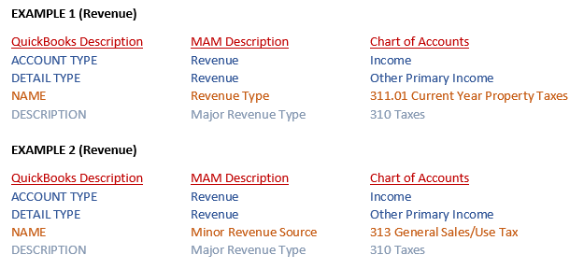
Examples of how to record revenue in QuickBooks

Slide 7
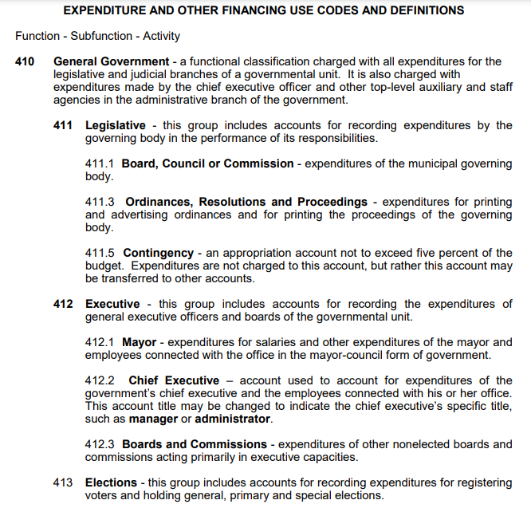
The Chart of Accounts
Expenditure and Other Financing
Use Codes and Definitions
Function
Subfunction
Activity
Object Classification
*Other financing ‘use’ sub-functions will be recorded like expenditures.
*Expenditures will be recorded as an expenditure sub-function or activity. No expenditures will be recorded at the expenditure function level.

Slide 8

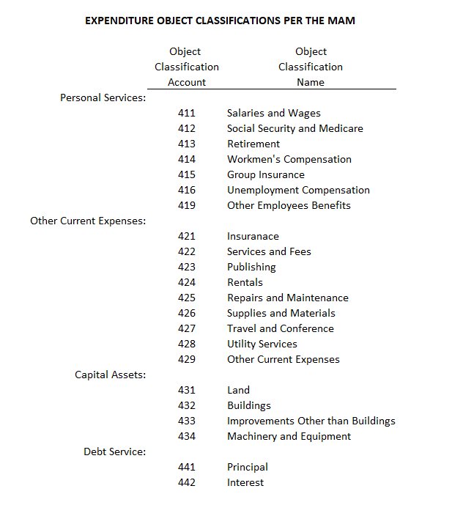

Slide 9
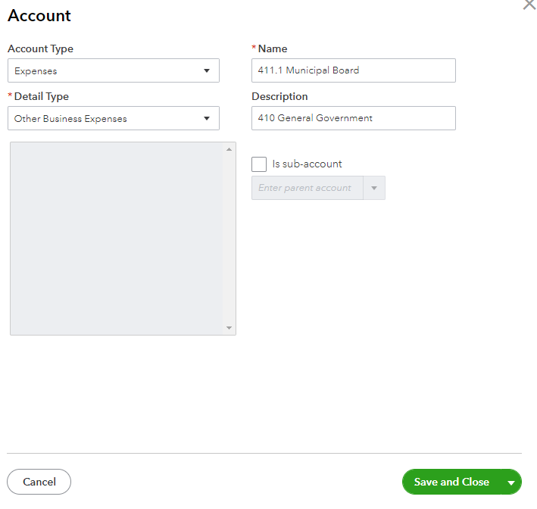
The Chart of Accounts for Governmental Funds
Adding a New Expense Account
Select “Lists/Chart of Accounts” from the Menu Bar
Click the “Account” button & choose “New”
Choose an account type (EXPENSES)
Choose a detail type (OTHER BUSINESS EXPENSE)
Type a name (Specific Expenditure Subfunction or Activity per MAM)
Type a description (Expenditure Function)
Click “Save & Close”

Slide 10
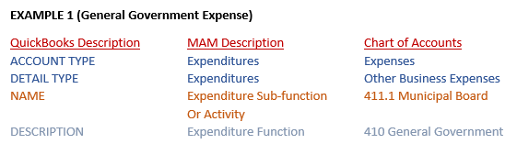
Example of General Government Expense Account

Slide 11
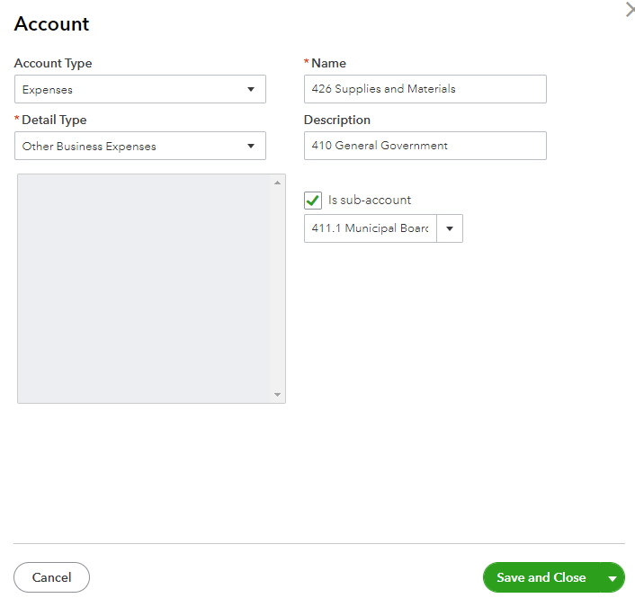
Adding Sub-Accounts
Adding a Sub-Account
Select “Lists/Chart of Accounts” from the Menu Bar
Click the “Account” button & choose “New”
Choose an account type (EXPENSES)
Choose a detail type (OTHER BUSINESS EXPENSE)
Type a name (Expenditure Object Classification per MAM)
Type a description (Expenditure Function)
Choose sub-account (Expenditure Sub-function or Activity)
Click “Save & Close”
Be sure to check “Is sub-account”

Slide 12
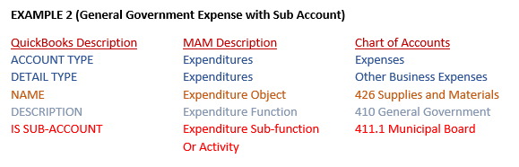
Example of General Government Expense Account with Sub-Account (Sub-function or Activity)

Slide 13

The Chart of Accounts for Enterprise Funds
Adding a New Expense Account
Select “Lists/Chart of Accounts” from the Menu Bar
Click the “Account” button & choose “New”
Choose an account type (EXPENSES)
Choose a detail type (OTHER BUSINESS EXPENSE)
Type a name (Expenditure Object Classification per MAM)
Type a description (Enterprise Operations or leave blank)
Click “Save & Close”

Slide 14
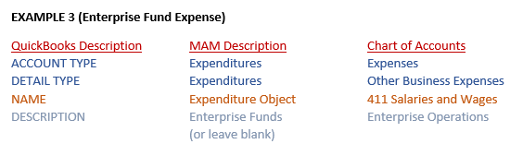
Example of Expense Account for Enterprise Fund

Slide 15
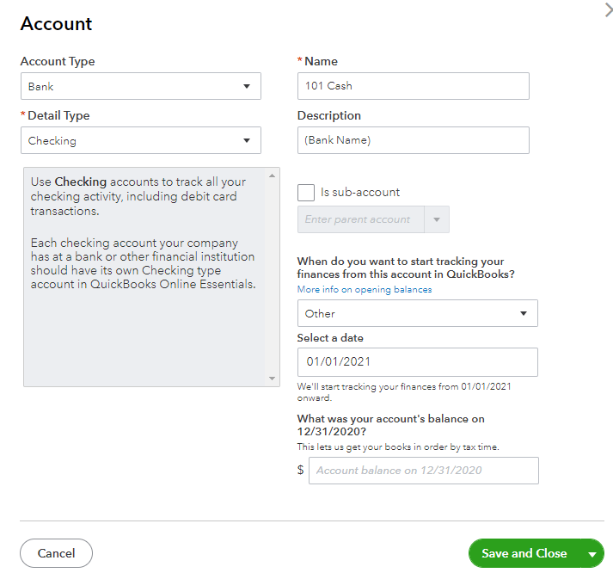
The Chart of Accounts
Assets – Cash
Select “Lists/Chart of Accounts” from the Menu Bar
Click the “Account” button & choose “New”
Choose an account type (BANK)
Choose a detail type (CHECKING, SAVINGS)
Type a name (101 Cash, 105 Savings/CD’s, 107 Restricted Cash, 262 Fund Balances)
Type a description (Bank Name)
Click “Save & Close”

Slide 16
Editing or Deleting Accounts
Editing an Account
Select “Lists/Chart of Accounts” from the Menu Bar
Click to highlight the account
Click the “Account” button and choose “Edit Account”
Edit the information and click “Save and Close”
Deleting or Inactivating an Account
Select “Lists/Chart of Accounts” from the Menu Bar
Click to highlight the account
Click the “Account” button and choose “Make Account Inactive” or “Delete Account”
Click “Ok” to confirm any deleted accounts

Slide 17
TIPS
You must first set up an account, before you can create a sub-account.
Account Type:
Bank, Income, Expenses
Detail Type:
Checking Account, Other Primary Income, Other Business Expenses
Name:
Minor Revenue Source, Revenue Type, Expenditure Sub-function, Expenditure Activity, Expenditure Object
Cash, Savings, CD’s, Restricted Cash, Fund Balance
When recording revenue/expenses, always choose the applicable account name.

Slide 18
Make sure QuickBooks is set to “Cash Basis”
under Preferences!
.

Slide 19

Continue adding all Revenue and Expense Accounts that the Municipality will use.
Refer to the S.D. Municipal Accounting Manual - Chart of Accounts at:
https://legislativeaudit.sd.gov/resources/municipalities/accountingmanual/accountingmanual.aspx

